Slide 1

Revenue Insights in the Hospitality Domain Using Power Bi

Slide 2

REVENUE INSIGHTS FOR AtliQ GROWTH

Slide 3
AtliQ Grands owns multiple five-star hotels across India. They have been in the hospitality industry for the past 20 years.
Welcome to the AtliQ Grands Revenue Insights project! In this project, I have implemented data analytics using Power BI to empower AtliQ Grands with the ability to make data-driven decisions, surpass competitors in the market, and drive growth in various aspects like Market Share & Revenue

Slide 4
Business problem:
AtliQ Grands is the proud owner of numerous opulent hotels throughout India. Yet, AtliQ Grands is experiencing a decline in market share and revenue within the luxurious/business hotel sector. As a data analyst, I figure out the key problem of declining revenue using data analytics.
Key Performance Metrics:
Revenue: Measure the total revenue generated by AtliQ Grands.
Realization Percentage: Calculate the percentage of actual revenue compared to the potential revenue.
Occupancy Percentage: Analyze the percentage of occupied rooms relative to the total available rooms.
Average Daily Revenue: Determine the average revenue earned per day.
Daily Booked Rooms per Night: Track the number of rooms booked daily.
Average Rating: Evaluate the average customer rating for the hotels.

Slide 5
Data modeling:
Data modeling plays a pivotal role and serves as the foundation for generating meaningful reports.
The entire framework of visualizations is constructed upon a well-designed data model.
Neglecting proper data modeling can have adverse effects on the overall performance of the generated reports.
In the context of this project, we have meticulously followed the Snowflake data modeling method. This approach involves structuring data into normalized forms, resulting in reduced redundancy and improved query performance. This methodology enhances the way we organize and process data, ensuring optimal results for our analysis.
Remember, a robust data model is the cornerstone of effective data analysis and reporting. By employing sound data modeling practices, we can confidently generate insightful visualizations that empower data-driven decision-making.

Slide 6
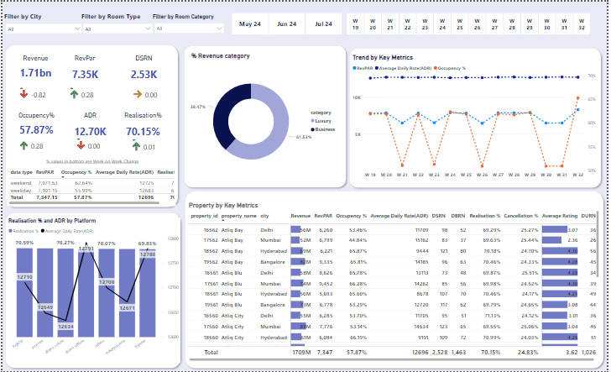

Slide 7
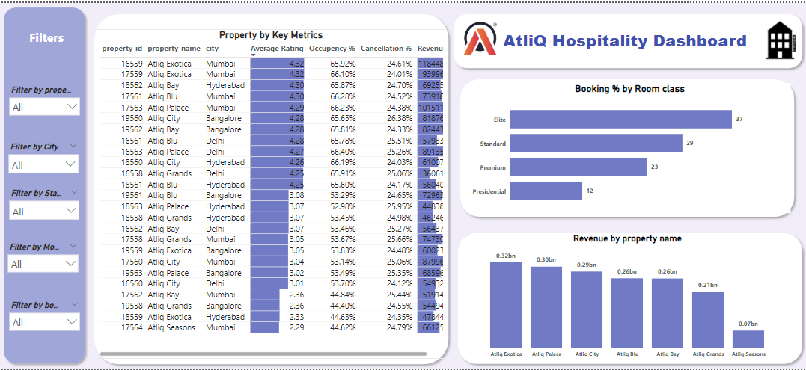

Slide 8
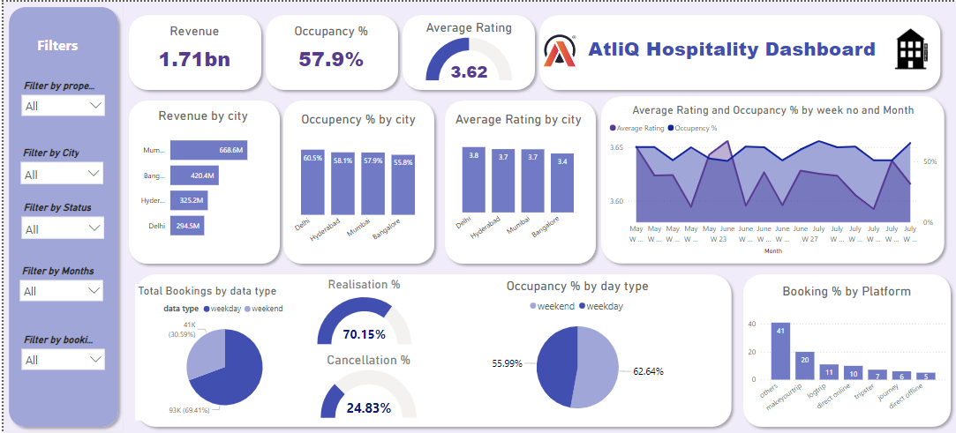

Slide 9
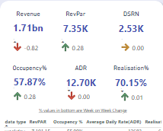
Key Findings from this dashboard:
The dashboard was utilized in an attempt to observe all the significant key metrics on a weekly basis. The metrics of Realisation, ADR, and RevPar remained constant, with only a slight fluctuation in occupancy ranging from 50% to 60% when filtering the data according to the week. Throughout the entirety of the period, both occupancy and cancellation rate remained in close proximity to the benchmark set by the industry.
Furthermore, Realisation, ADR, and RevPar also sustained a similar consistency when comparing weekdays to weekends.
Upon arranging the occupancy rate in descending order within the key metrics table, it becomes evident that there exists a correlation between the rating and occupancy.

Slide 10
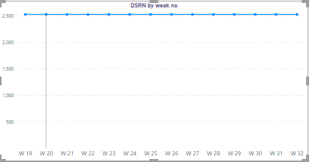
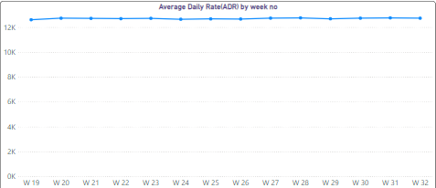
DSRN
Insights and suggestions:
ADR and DSRN Remains Stable
Upon analyzing the dashboard, it’s evident that the Average Daily Rate (ADR) and DSRN (Daily Sellable Room Nights) for AtliQ Hotels has remained relatively stable over the given time frame.
This stability in pricing indicates a consistent pricing strategy. Notably, AtliQ Hotels currently do not employ dynamic pricing based on weekdays and weekends.
This presents an opportunity to consider adjusting the pricing strategy. Dynamic pricing can help optimize revenue by offering different rates for weekdays and weekends, aligning pricing more closely with demand fluctuations.
This insight suggests that exploring dynamic pricing strategies could be a valuable initiative to consider, potentially leading to increased revenue and better revenue management.
ADR

Slide 11
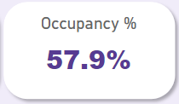
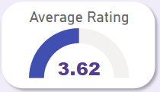
Overall Occupancy Rate:
The overall occupancy rate for AtliQ Grands’ properties currently stands at a solid 57%. This figure reflects the percentage of available rooms that are being utilized by guests. A 57% occupancy rate indicates a substantial portion of rooms are booked, contributing positively to revenue.
Maintaining a healthy occupancy rate is crucial for optimizing revenue and resource management. This insight suggests that AtliQ Grands has been successful in attracting guests and efficiently filling available rooms.
Average Rating:
The average guest rating for AtliQ Grands’ properties is a commendable 3.62. This rating, derived from guest reviews and surveys, reflects the overall satisfaction of guests who have experienced our hospitality.
A rating of 3.62 signifies a positive guest experience, with the majority of guests expressing satisfaction with their stays. Guest ratings are a vital indicator of our service quality and the guest experience we provide.

Slide 12
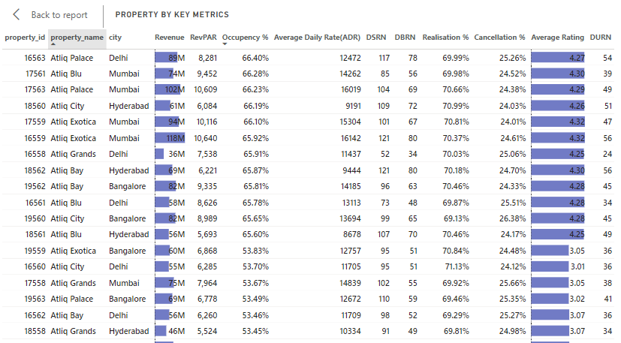

Slide 13
when the hotel is sorted by its occupancy rate, we observe a relationship that exists between ratings and occupancy. Consequently, we recommend examining the reviews provided by customers on all booking platforms, addressing and resolving any issues raised by them.
As we can see realisation% and ADR trends by booking platform remained similar and the average difference of $150. we checked the weeks, the trend has no significant difference. Even direct offline and direct online have similar realization and ADR. offering coupons and cashback incentives directly to customers who book rooms through the hotel’s website or offline at checkout can be an effective strategy to increase revenue realization, even without discouraging the use of third-party booking platforms. “realization” in the context of the hospitality industry, refers to the percentage of revenue retained after accounting for cancellations and no-shows.
Suggestions:
Suggested, ways to raise revenue is enhance occupancy rates.
Take advantage of late bookings and additional days of stay to increase revenue.
Maintain Occupancy Percentage is maximum on Weekends
Maximum bookings are done through others and makeyourtrip platform , must focus on platforms from where people prefer less bookings.
Average rating is between 3.65 and 3.6 so try to pull the reasons from the hotels where hotel ratings are very low and fix them ASAP for generating the more engagement.
Mumbai is showing high average rating but those cities have rating below 3 so fix them by understanding the reasons behind low ratings.
Fixed the issue highlighted by the customer in low-rated hotels to Increase occupancy rate.
Dynamic pricing strategy
Offering coupons and cashback incentives directly to customers who book rooms through the hotel’s website or offline at checkout THUS INCREASE realization.

